Slide 1
The Educational Alliance of Canford Heath (TEACH Poole)
Gender Pay Gap Reporting
for dataset: Gender Pay Gap 2025

Slide 2

This report has been produced for your organisation. It includes all the figures required for Gender Pay Reporting under the Employment Equality Act 1998 (Section 20A) (Gender Pay Gap Information) Regulations 2022.
It also provides a detailed analysis of all your datapoints mapped in the Gapsquare app. This allows your company to break down your organization-wide metrics into smaller groups of employees - for example, you could look at employees by age, job level, business unit, or any other custom label.

Slide 3
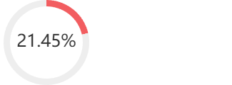
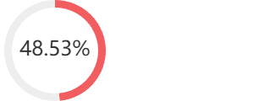
Headline Figures
Hourly remuneration
Women's mean hourly rate is 21.45% less
Mean pay per hour for men: 23.32
Mean pay per hour for women: 18.32
Difference in pay: 5.00
Women's median hourly rate is 48.53% less
Median pay per hour for men: 25.77
Median pay per hour for women: 13.26
Difference in pay: 12.51

Slide 4

Pay

Slide 5


Hourly remuneration
Women's mean hourly rate is 21.45% less
Mean pay per hour for men: 23.32
Mean pay per hour for women: 18.32
Difference in pay: 5.00
Women's median hourly rate is: 48.53% less
Median pay per hour for men: 25.77
Median pay per hour for women: 13.26
Difference in pay: 12.51

Slide 6
Detailed Report Analysis By Quartiles
Group | Mean Pay Ms | Mean Pay Fs | Pay Gap (mean) | Pay Gap (median) | Percentage of Ms | Percentage of Fs | Contribution to Pay Gap
Lower quartile | 12.00 | 12.67 | -5.64% | -5.7% | 7.14% | 92.86% | -6.80%
Lower middle quartile | 0.00 | 13.22 | -100% | -100% | 0.00% | 100.00% | -16.20%
Upper middle quartile | 18.56 | 18.66 | -0.52% | -0.01% | 16.07% | 83.93% | 7.35%
Upper quartile | 29.62 | 32.05 | -8.22% | -0.18% | 25.45% | 74.55% | 37.10%

Slide 7
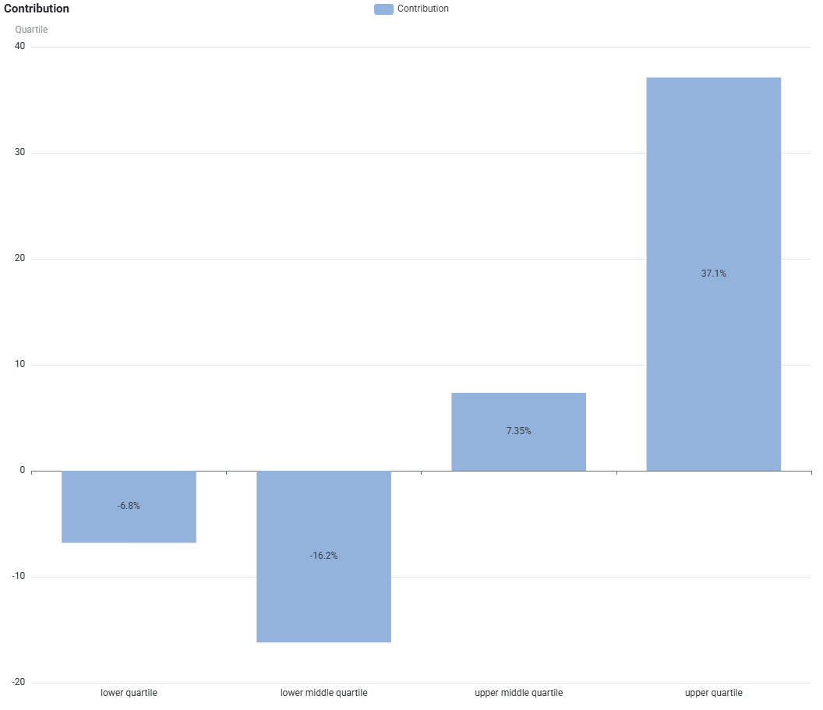
The Contribution section shows how a given sub-category (i.e. Quartile) contributes in percentage points towards your mean pay gap.
Contribution of Each Quartile to the Pay Gap

Slide 8
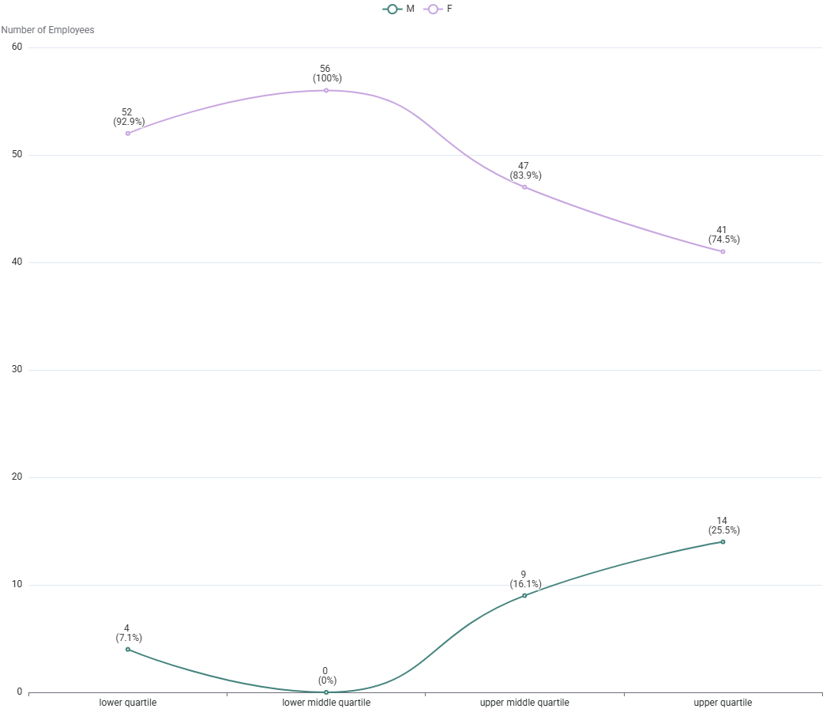
This graph shows the data broken down into 4 equally sized groups ranging from the lowest to the highest paid employees. This graph shows the difference in the actual numbers of employees within the separate pay quartiles.
Workforce Representation by Quartiles

Slide 9
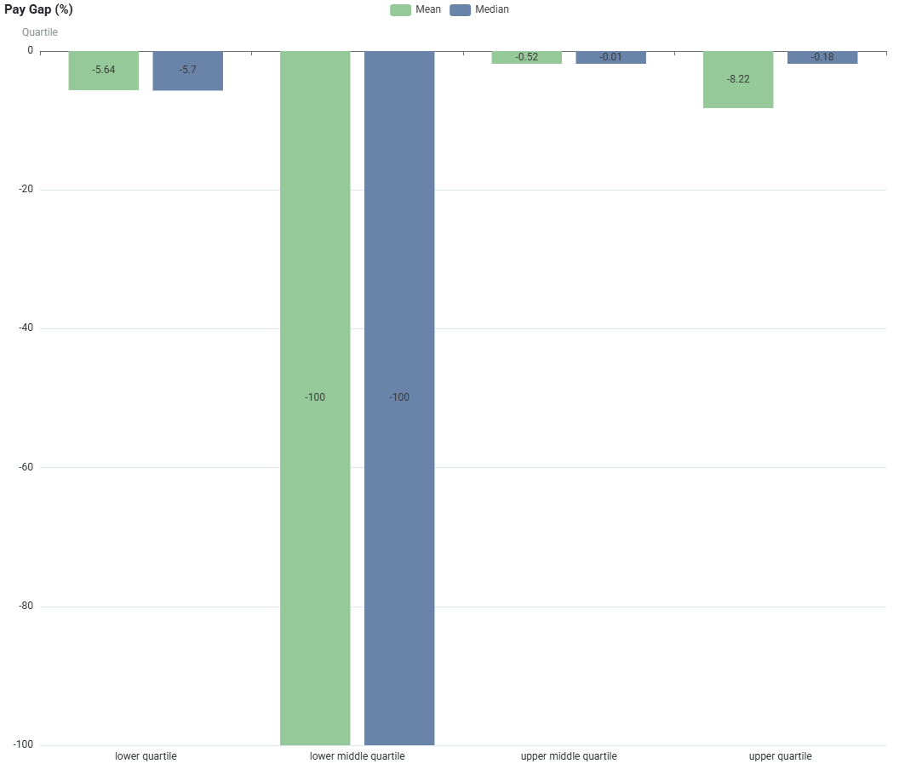
Each Quartile has its own separate pay gap, comparing them shows what levels of pay present the key imbalances and breaks down your organisation’s overall pay gap.
Pay Gaps by Quartiles

Slide 10
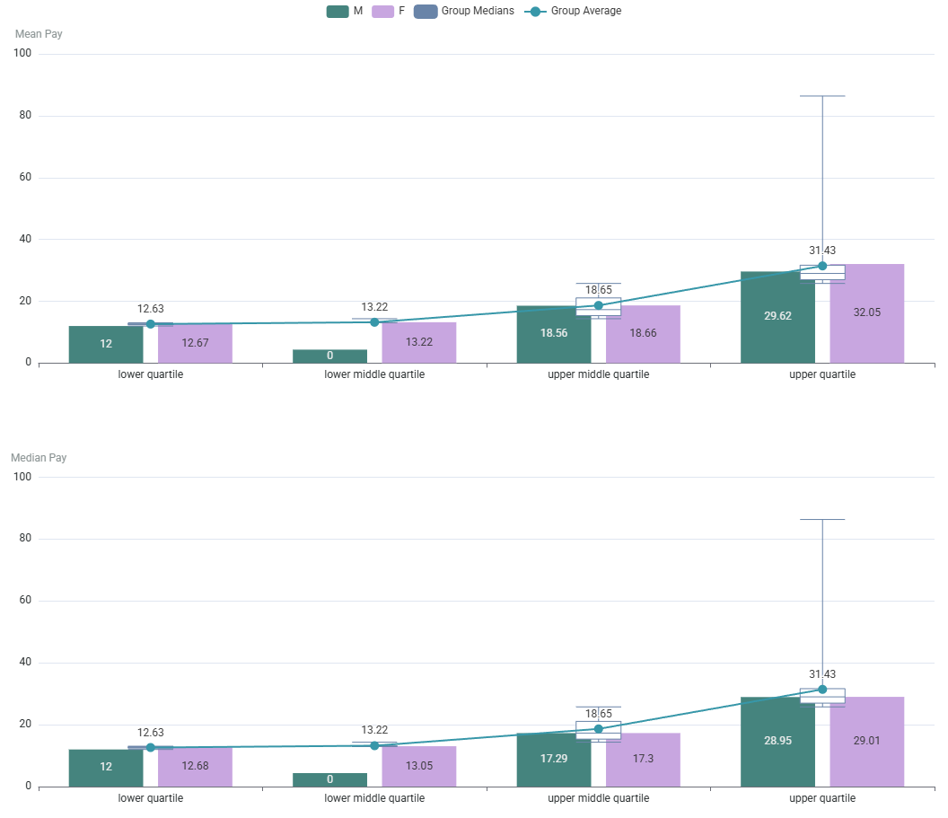
This chart shows you the pay ranges that provide the averages of Mean and Median for comparison.
Pay Ranges by Quartiles

Slide 11

Glossary of terms
Group:
The name of the groups is taken from your data, using the same terms you have mapped in the Pay Equity Analytics app.
Mean Pay Gap:
The raw difference between men's average pay and women's average pay, usually expressed as a percentage. This can be affected by outliers.
Median Pay Gap:
The difference in pay between the middle-paid man and middle-paid woman in your organisation, usually expressed as a percentage. This is less affected by outliers.
Quartile:
A division of your entire organisation into four groups of equal numbers, starting from the lowest-paid group (lower quartile) to your highest-paid group (upper quartile).
Contribution to Pay Gap:
The number of percentage points a group contributes to your overall mean pay gap, whereby summing all your contributions per group will give you the mean pay gap. Using this, you will see which group contributes most to your organisation's pay gap.

Slide 12
Thank you

